Slide 1
Marilyn Monroe.

Slide 2
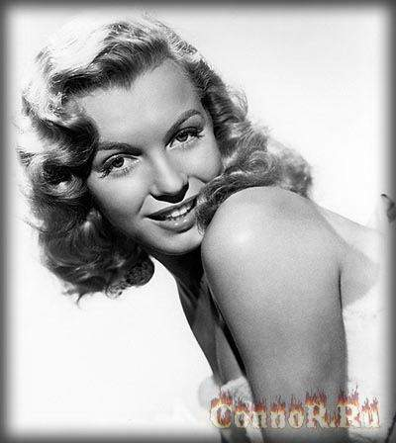
Marilyn Monroe. Real name: Norma Jean Baker Mortenson. Marilyn Monroe was born on 06/01/1926 in Los Angeles, died on 08.05.1962 in Breytvude (California). She studied at the Actors Studio in New York. The legend in his lifetime and a legend after his death, Marilyn Monroe lived a bright, but short and difficult life.

Slide 3
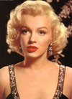
It shows Marilyn Monroe.

Slide 4
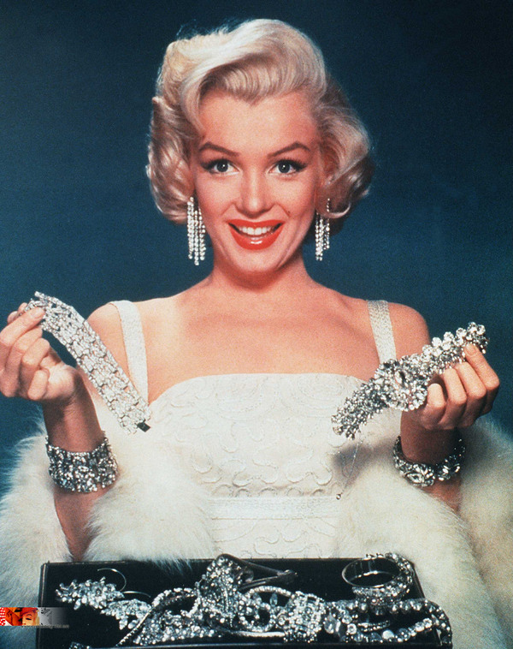
Sex symbol of America, the subject of dreams of thousands of men, the beauty that is envied by millions of women, the actress, whose rapid "rise" to the top of kinoolimpa seemed a miracle, it was really tragic figure.

Slide 5
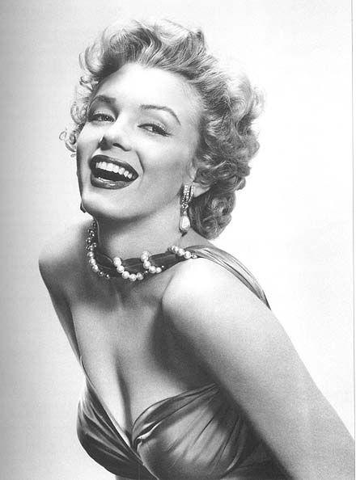
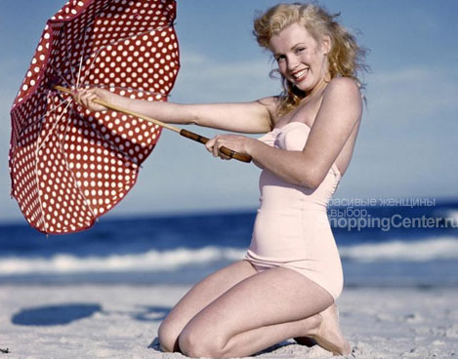
Beauty Marilyn Monroe.

Slide 6
A failed love life and vain attempts to prove the directors that "the beauty of Merlin" is able to do more on screen than a demonstration of its charms - these are the main causes of the tragedy in a rich house, where the morning of August 5, 1962 police found the body of Merlin.

Slide 7
The End.

